Slide 1
Lecture 34-36
Concurrency control

Slide 2
Outline
Concurrency Control
Need for Concurrency Control
Lock-Based Protocols
Timestamp-Based Protocols
Deadlock handling

Slide 3
Concurrency Control
In the concurrency, the multiple transactions can be executed simultaneously.
When several transactions execute concurrently in the database, however, the isolation property may no longer be preserved.
To ensure that it is, the system must control the interaction among the concurrent transactions; this control is achieved through one of a variety of mechanisms called concurrency control schemes.
The goal of concurrency-control policies is to provide a high degree of concurrency, while ensuring that all schedules that can be generated are serializable, recoverable.
Notes:
Aim of concurrency control is to make schedules reverable or
In practice, the most frequently used schemes are two-phase locking and snapshot isolation.

Slide 4
Need for Concurrency Control
Three examples of potential problems caused by concurrency:
Lost update problem.
Uncommitted dependency problem or Dirty Read Problem
Unrepeatable Read Problem

Slide 5
Lost Update Problem
This problem occurs when multiple transactions execute concurrently and updates from one or more transactions get lost.
Successfully completed update is overridden by another user.

Slide 6
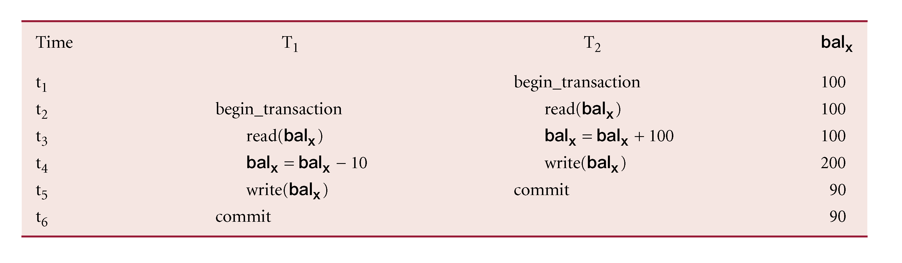
Lost Update Problem
Notes:
T₁ withdrawing £10 from an account with bal_{x}, initially £100.
T₂ depositing £100 into same account.
Serially, final balance would be £190.
This problem occurs whenever there is a write-write conflict.
In write-write conflict, there are two writes one by each transaction on the same data item without any read in the middle.

Slide 7
Uncommitted Dependency Problem
Occurs when one transaction can see intermediate results of another transaction before it has committed.
There is always a chance that the uncommitted transaction might fail or roll back later.
Sometimes referred as dirty Read Problem

Slide 8
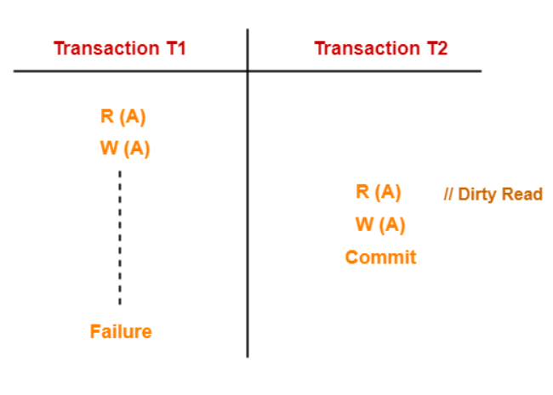
Uncommitted Dependency Problem
Notes:
T₄ updates bal_{x} to £200 but it aborts, so bal_{x} should be back at original value of £100.
T₃ has read new value of bal_{x} (£200) and uses value as basis of £10 reduction, giving a new balance of £190, instead of £90.

Slide 9
Unrepeatable Read Problem
This problem occurs when a transaction gets to read unrepeated i.e. different values of the same variable in its different read operations even when it has not updated its value.

Slide 10
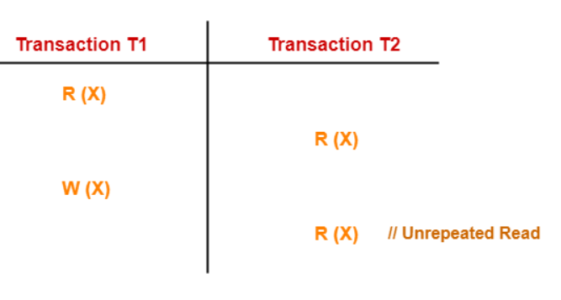
Unrepeatable Read Problem
Notes:
T₆ is totaling balances of account x (£100), account y (£50), and account z (£25).
Meantime, T₅ has transferred £10 from bal_{x} to bal_{z}, so T₆ now has wrong result (£10 too high).

Slide 11
Concurrency Control Techniques
The most common concurrency control techniques are:
Locking protocols
timestamp ordering schemes
Validation techniques
Multiversion schemes

Slide 12
Lock-Based Protocols
A locking protocol is a set of rules that state when a transaction may lock and unlock each of the data items in the database.
Data items can be locked in two modes :
exclusive (X) mode. Data item can be both read as well as written. X-lock is requested using lock-X instruction.
shared (S) mode. Data item can only be read. S-lock is requested using lock-S instruction.
Notes:
A locking protocol is a set of rules followed by all transactions while requesting and releasing locks. Locking protocols restrict the set of possible schedules.
Lock requests are made to the concurrency-control manager by the programmer. Transaction can proceed only after request is granted.

Slide 13
Locking - Basic Rules
If transaction has shared lock on item, can read but not update item.
If transaction has exclusive lock on item, can both read and update item.
Reads cannot conflict, so more than one transaction can hold shared locks simultaneously on same item.
Exclusive lock gives transaction exclusive access to that item.
Some systems allow transaction to upgrade read lock to an exclusive lock, or downgrade exclusive lock to a shared lock.
Notes:
If a lock cannot be granted, the requesting transaction is made to wait till all incompatible locks held by other transactions have been released. The lock is then granted.

Slide 14
Lock-compatibility matrix
Request
 | S | X
S
X
Shared Shared
Shared Exclusive
Exclusive Shared
Exclusive Exclusive
Grant

Slide 15
Lock-compatibility matrix
Request
 | S | X
S | True
X
Shared Shared
Shared Exclusive
Exclusive Shared
Exclusive Exclusive
Grant

Slide 16
Lock-compatibility matrix
Request
 | S | X
S | True | False
X
Shared Shared
Shared Exclusive
Exclusive Shared
Exclusive Exclusive
Grant

Slide 17
Lock-compatibility matrix
Request
 | S | X
S | True | False
X | False
Shared Shared
Shared Exclusive
Exclusive Shared
Exclusive Exclusive
Grant

Slide 18
Lock-compatibility matrix
Request
 | S | X
S | True | False
X | False | False
Shared Shared
Shared Exclusive
Exclusive Shared
Exclusive Exclusive
Grant

Slide 19
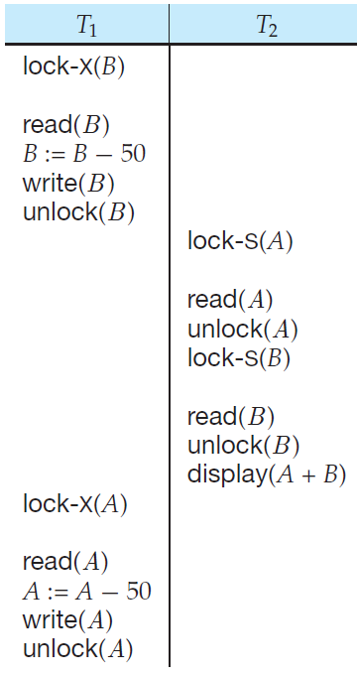
Example of a transaction performing locking
T1 T2
lock-X(B); .
read(B); lock- X(B)
write(B); .
unlock(B); read(B);
write(B);
unlock(B);
Simple shared/ exclusive locking is may not enough to produce serializable, recoverable schedule.

Slide 20
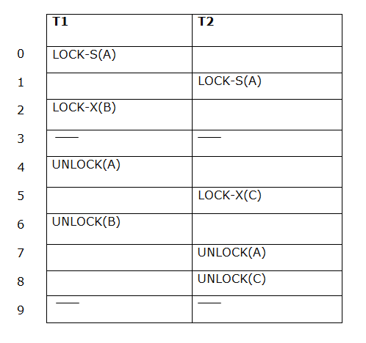
The Two-Phase Locking Protocol
This protocol ensures conflict-serializable schedules.
Phase 1: Growing Phase
Transaction may obtain locks
Transaction may not release locks
Phase 2: Shrinking Phase
Transaction may release locks
Transaction may not obtain locks
The protocol assures serializability. It can be proved that the transactions can be serialized in the order of their lock points (i.e., the point where a transaction acquired its final lock). T1 →T2

Slide 21
Lock Conversions
Two-phase locking with lock conversions:
– First Phase:
can acquire a lock-S on item
can acquire a lock-X on item
can convert a lock-S to a lock-X (upgrade)
– Second Phase:
can release a lock-S
can release a lock-X
can convert a lock-X to a lock-S (downgrade)

Slide 22
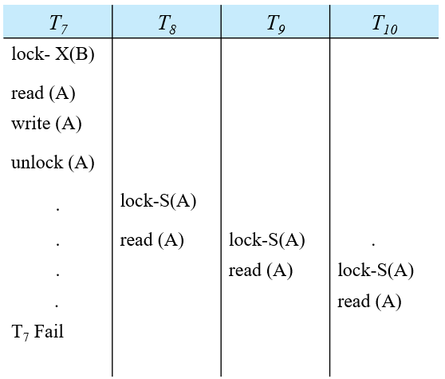
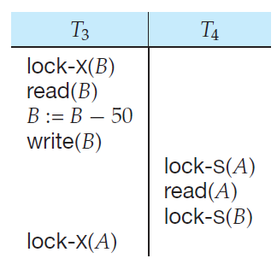
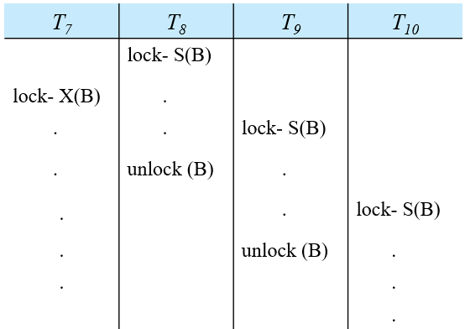
Drawbacks of 2pl
Two-phase locking does not ensure freedom from deadlock, irrecoverability, starvation and Cascading rollbacks
T₅ | T₆
lock- X(B)
read (B)
write (B) | lock- X(B)
unlock (B) | read (B)
. | write (B)
. | commit
.
rollback

Slide 23
Strict Two-phase locking (Strict-2PL)
The first phase of Strict-2PL is similar to 2PL. In the first phase, after acquiring all the locks, the transaction continues to execute normally.
The only difference between 2PL and strict 2PL is that Strict-2PL does not release a lock after using it.
This protocol requires not only that locking be two phase, but also that all exclusive-mode locks taken by a transaction be held until that transaction commits.

Slide 24
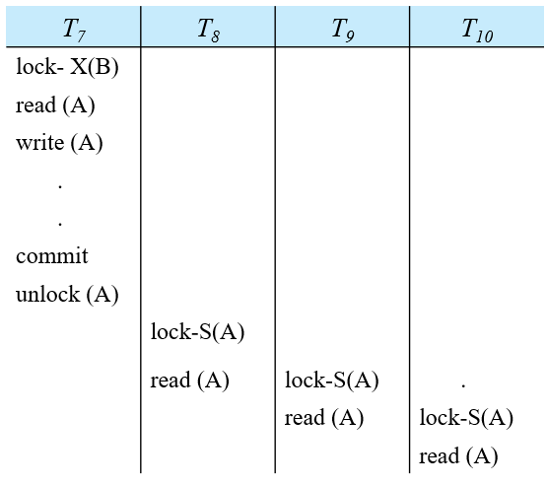
Improvements in 2PL
Cascading rollbacks and irrecoverability can be avoided in 2PL
T₅ | T₆
lock- X(B)
read (B)
write (B) | lock- X(B)
 | .
 | .
commit
unlock (B)
 | read (B)
 | write (B)
 | commit

Slide 25
Timestamping ordering protocol
Transactions ordered globally so that older transactions, transactions with smaller timestamps, get priority in the event of conflict.
Timestamp is a unique identifier created by DBMS that indicates relative starting time of a transaction. Can be generated by using system clock at time transaction started, or by incrementing a logical counter every time a new transaction starts.
Conflict is resolved by rolling back and restarting transaction.
No locks so no deadlock.

Slide 26
Timestamping ordering protocol
Each transaction is issued a timestamp when it enters the system. If an old transaction T_{i} has time-stamp TS(T_{i}), a new transaction T_{j} is assigned time-stamp TS(T_{j}) such that TS(T_{i}) <TS(T_{j}).
In order to assure such behavior, the protocol maintains for each data Q two timestamp values:
W-timestamp(Q) is the largest time-stamp of any transaction that executed write(Q) successfully.
R-timestamp(Q) is the largest time-stamp of any transaction that executed read(Q) successfully.
Notes:
Read/write proceeds only if last update on that data item was carried out by an older transaction.
Otherwise, transaction requesting read/write is restarted and given a new timestamp.
Also timestamps for data items:
read-timestamp - timestamp of last transaction to read item;
write-timestamp - timestamp of last transaction to write item.

Slide 27
Example
T1 → older TS(10)
T2 → younger TS (20)
T1 T2
Read(X)
Read(X)
ReadTimeStamp : RTS(20)
T1 → older TS(10)
T2 → younger TS (20)
T1 T2
write (X)
write(X)
WriteTimeStamp : WTS(10)

Slide 28
Timestamping- Read (x)
The timestamp ordering protocol ensures that any conflicting read and write operations are executed in timestamp order.
Suppose a transaction Ti issues a read(X)
If TS(Ti) < W-timestamp(X), then Ti needs to read a value of X that was already overwritten.
Hence, the read operation is rejected, and Ti is rolled back.
If TS(Ti) >= W-timestamp(X), then the read operation is executed, and R-timestamp(X) is set to max(R-timestamp(X), TS(Ti)).
T1 → older TS(10)
T2 → younger TS (20)
T1 T2
write(x)
read (x)
WriteTimeStamp : WTS(20)
TS(10) < WTS(20)

Slide 29
Timestamping- write (x)
Suppose that transaction Ti issues write(X).
If TS(Ti) < R-timestamp(X), then the value of X that Ti is producing was needed previously, and the system assumed that that value would never be produced.
Hence, the write operation is rejected, and Ti is rolled back.
If TS(Ti) < W-timestamp(Q), then Ti is attempting to write an obsolete value of X.
Hence, this write operation is rejected, and Ti is rolled back.
Otherwise, the write operation is executed, and W-timestamp(Q) is set to TS(Ti).

Slide 30
Timestamping- write (x) Example
T1 → older TS(10)
T2 → younger TS (20)
T1 T2
read(x)
write (x)
ReadTimeStamp : RTS(20)
TS(10) < RTS(20)
T1 → older TS(10)
T2 → younger TS (20)
T1 T2
write(x)
write (x)
WrtiteTimeStamp : WTS(20)
TS(10) < WTS(20)
T1 → older TS(10)
T2 → younger TS (20)
T1 T2
write(x)
read(x)
WrtiteTimeStamp : WTS(10)
TS(20) < WTS(10)

Slide 31
Thomas’ Write Rule
Modified version of the timestamp-ordering protocol in which obsolete write operations may be ignored under certain circumstances.
When T_{i} attempts to write data item X, if TS(T_{i}) < W-timestamp(X), then T_{i} is attempting to write an obsolete value of {X}.
Rather than rolling back T_{i} as the timestamp ordering protocol would have done, this {write} operation can be ignored.
Otherwise this protocol is the same as the timestamp ordering protocol.
Thomas' Write Rule allows greater potential concurrency.

Slide 32
Starvation / Deadlock
Two-phase locking does not ensure freedom from deadlocks and starvation
Starvation occurs if the concurrency control manager is badly designed. For example:
A transaction may be waiting for an X-lock on an item, while a sequence of other transactions request and are granted an S-lock on the same item.
The same transaction is repeatedly rolled back due to deadlocks.
Concurrency control manager can be designed to prevent starvation.

Slide 33
Deadlock
A deadlock is a condition where two or more transactions are waiting indefinitely for one another to give up locks. Deadlock is said to be one of the most feared complications in DBMS as no task ever gets finished and is in waiting state forever.

Slide 34
Deadlock handling
Only one way to break deadlock: abort one or more of the transactions.
Deadlock should be transparent to user, so DBMS should restart transaction(s).
There are two principal methods for dealing with the deadlock problem.
Deadlock prevention.
Deadlock detection and recovery.
Notes:
We can use a deadlock prevention protocol to ensure that the system will never enter a deadlock state. Alternatively, we can allow the system to enter a deadlock state,
and then try to recover by using a deadlock detection and deadlock recovery scheme.

Slide 35
Deadlock Prevention
Deadlock prevention protocols ensure that the system will never enter into a deadlock state. Some prevention strategies:
Require that each transaction locks all its data items before it begins execution (predeclaration).
Impose ordering of all data items and require that a transaction can lock data items only in the sequence specified with ordering.

Slide 36
More Deadlock Prevention Strategies
Following schemes use transaction timestamps for the sake of deadlock prevention alone.
wait-die scheme — non-preemptive
older transaction may wait for younger one to release data item. (older means smaller timestamp) Younger transactions never wait for older ones; they are rolled back instead.
a transaction may die several times before acquiring needed data item
wound-wait scheme — preemptive
older transaction wounds (forces rollback) of younger transaction instead of waiting for it. Younger transactions may wait for older ones.
may be fewer rollbacks than wait-die scheme.
Tn Tm
Q

Slide 37
More Deadlock Prevention Strategies
Ttimeouts: transaction that requests lock will only wait for a system-defined period of time.
If lock has not been granted within this period, lock request times out.
In this case, DBMS assumes transaction may be deadlocked, even though it may not be, and it aborts and automatically restarts the transaction.

Slide 38
Deadlock Detection
Deadlocks can be described as a wait-for graph, which consists of a pair G = (V,E),
V is a set of vertices (all the transactions in the system)
E is a set of edges; each element is an ordered pair T_{i} →T_{j}.
If T_{i} → T_{j} is in E, then there is a directed edge from T_{i} to T_{j}, implying that T_{i} is waiting for T_{j} to release a data item.
When T_{i} requests a data item currently being held by T_{j}, then the edge T_{i} → T_{j} is inserted in the wait-for graph. This edge is removed only when T_{j} is no longer holding a data item needed by T_{i}.
The system is in a deadlock state if and only if the wait-for graph has a cycle. Must invoke a deadlock-detection algorithm periodically to look for cycles.

Slide 39
Deadlock Detection (Cont.)
Wait-for graph without a cycle
Wait-for graph with a cycle

Slide 40
Deadlock Recovery
When deadlock is detected :
Some transaction will have to rolled back (made a victim) to break deadlock. Select that transaction as victim that will incur minimum cost.
Rollback -- determine how far to roll back transaction
Total rollback: Abort the transaction and then restart it.
More effective to roll back transaction only as far as necessary to break deadlock.
Starvation happens if same transaction is always chosen as victim. Include the number of rollbacks in the cost factor to avoid starvation

Slide 41
Suggested Reading
Chapter 22 of Database Systems: A Practical Approach to Design, Implementation, and Management by Thomas Conolly 6th Edition
Chapter 14, 15 of Database System Concepts by Abraham Silberschatz

Slide 42
References
https://www.db-book.com/db6/slide-dir/index.html
https://www.pearson.com/us/higher-education/product/Connolly-Powerpoint-Slides-for-Database-Systems
https://www.gatevidyalay.com/equivalence-of-schedules-equivalent-schedules-in-dbms/

